Slide 1
Transmission media
CSC 223

Slide 2
Introduction
A transmission medium can be broadly defined as anything that can carry information from a source to a destination.
Transmission media is a physical path by which a message transfers from sender to receiver.

Slide 3

Transmission media

Slide 4
Key considerations and design factors
In considering the design of data transmission systems, key concerns are data rate and distance: the greater the data rate and distance the better.
Design factors relating to the transmission medium and the signal determine the data rate and distance:
  Bandwidth:
  Transmission impairments:
  Interference:
  Number of receivers:

Slide 5
Classes of transmission media
Transmission media can be divided into two categories: guided media and unguided media.
Guided media include twisted-pair cable, coaxial cable and fiber-optic cable.
Unguided media is wireless such as radio and lasers through the air.

Slide 6

Classes of transmission media

Slide 7
Guided Transmission Media
Twisted Pair
Coaxial cable
Optical fiber
Unguided Transmission Media
Terrestrial microwave
Satellite
Infrared

Slide 8
Guided media
Guided media are provided a channel from one device to another device, such as twisted- pair cable, coaxial cable and fiber-optic cable. Twisted-pair and coaxial cable use metallic (copper) conductors that accept and transform signals in the form of electrical current.
Optical fiber on the other hand is a glass cable that accepts and transports signals in the form of light.

Slide 9
Types of guided media
Twisted-Pair Cable
Coaxial Cable
Fiber-Optic Cable

Slide 10
Twisted pair
The wires in Twisted Pair cabling are twisted together in pairs. Each pair would consist of a wire used for the +ve data signal and a wire used for the -ve data signal.
Any noise that appears on 1 wire of the pair would occur on the other wire. Twisted Pair cables are most effectively used in systems that use a balanced line method of transmission.

Slide 11
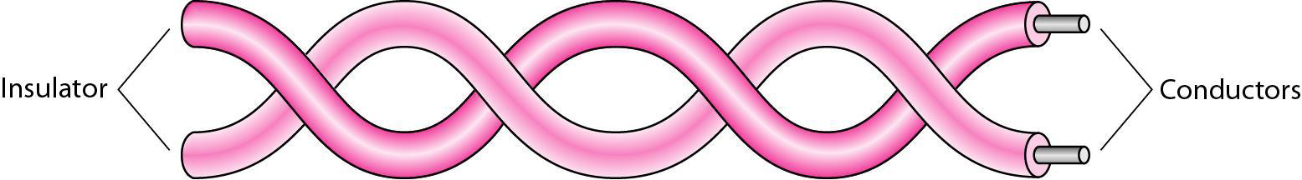
Twisted pair
The twisted pair cable is mostly used in telephone systems and in local area networks.

Slide 12
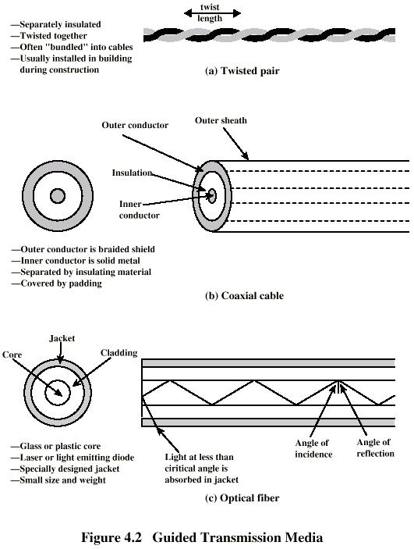
Twisted Pair

Slide 13
Twisted pair types
The most common twisted pair cable used in communication is referred as unshielded twisted pair(UTP).
The shielded twisted pair is enclosed in a metal foil or braided-mesh shield that protects against electromagnetic interference. STP improved the signal quality by preventing the penetration of noise or crosstalk. But it is bulkier and more expensive than UTP that is why it is seldom used.

Slide 14

Twisted pair types

Slide 15
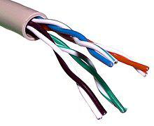
Unshielded Twisted Pair (UTP)

Slide 16
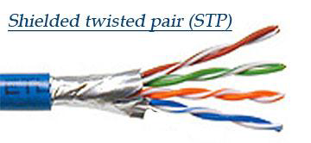
Shielded Twisted Pair (STP)

Slide 17
Advantages of twisted pair
The twisted-pair cable can be easily installed maintained.
The twisted-pair cable can be used for both analog and digital data transmission.
The twisted-pair cable is less expensive for transmission over a short distance.

Slide 18
UTP Categories
Cat 3
  up to 16MHz
  Voice grade found in most offices
  Twist length of 7.5 cm to 10 cm
Cat 4
  up to 20 MHz
Cat 5
  up to 100MHz
  Commonly pre-installed in new office buildings
  Twist length 0.6 cm to 0.85 cm
Cat 5E (Enhanced)
Cat 6
Cat 7

Slide 19
Twisted Pair - Applications
Most common medium
Telephone network
  Between house and local exchange
Within buildings
  To private branch exchange (PBX)
For local area networks (LAN)
  10Mbps or 100Mbps

Slide 20
Coaxial cable
The Coaxial Cable consists of 2 conductors. The inner conductor is held inside an insulator with the other conductor woven around it providing a shield.
An insulating protective coating called a jacket covers the outer conductor. The outer shield protects the inner conductor from outside electrical signals.

Slide 21
Coaxial cable
The distance between the outer conductor (shield) and inner conductor plus the type of material used for insulating the inner conductor determine the cable properties or impedance.
The excellent control of the impedance characteristics of the cable allows higher data rates to be transferred than Twisted Pair cable

Slide 22

Coaxial cable

Slide 23
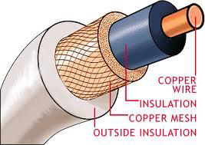

Slide 24
Coaxial Cable

Slide 25
Types of coaxial cable
Baseband coaxial cable, a 50 Ω cable, is commonly used in digital transmission. Baseband coaxial cable is used in some local area networks.
Broadband coaxial cable, a 75 Ω cable, is commonly used in analog transmission. Broadband coaxial cable is used in cable Television network and can be used in telephone system.

Slide 26
Advantages of coaxial cable
Bandwidth is much higher than twisted-pair cable. Although bandwidth depends on the cable length.
Coaxial cable is well-shielded than twisted-pair cable and has excellent noise immunity.
Coaxial cable can be used for both analog and digital transmission. For analog, 75 ohm broadband coaxial cable is used and for digital, 50 ohm Baseband coaxial cable is used.
Coaxial cable can cross a longer distance at higher data rate.
The coaxial cable is relatively inexpensive than optical fiber cable and easy to handle.

Slide 27
Disadvantage of coaxial cable
The attenuation is much higher than twisted-pair cable so needs repeaters frequently.

Slide 28
Coaxial Cable Applications
Most versatile medium
Television distribution
Long distance telephone transmission
  Can carry 10,000 voice calls simultaneously
  Being replaced by fiber optic
Short distance computer systems links
Local area networks

Slide 29
Fiber optic cable
A Fiber optics cable is made of very fine fibers of glass or plastic that accepts and transports signals in the form of light.
They consist of a glass core, roughly fifty micrometers in diameter, surrounded by a glass "optical cladding" giving an outside diameter of about 120 micrometers.

Slide 30

Fiber optic cable

Slide 31
Optical Fiber

Slide 32
Fiber optic cable
There are two types of light sources for which fiber cables are available. These sources of light are:
  1. Light Emitting Diodes (LEDs).
  2. Light Amplification bi stimulated Emission Radiation (Lasers).

Slide 33
Fiber optic cable
There are two types of modes for propagation of light along optical channel.
  1. Multimode.
  2. Single-Mode.

Slide 34
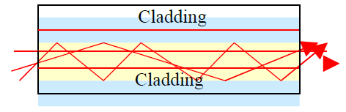
Multi mode
In multimode fiber multiple rays from a light source (LED) moves through the core in different paths. In multimode fibers, the core is 50 to 100 microns in diameter and 125 microns cladding.

Slide 35

Single mode
In single-mode fiber as the core’s diameter reduce, the light can moves in a straight line. As the core density is lower than multimode fiber, the critical angle that is close enough to 90 degrees, which make the propagation of beams almost straight.

Slide 36

Fiber optic connectors

Slide 37
Advantages of optical fiber
Fiber-optic cable carry signals with much less energy loss than twister cable or coaxial cable and with a much higher bandwidth. Hence the data rate data rate is also higher than other cables.
Fiber-optic cables are much lighter and thinner than copper cables with the same bandwidth. This means that much less space is required in underground cabling ducts. Also they are easier for installation engineers to handle.
No electric connection is required between the sender and the receiver.

Slide 38
Advantages of optical fiber
Fiber-optic cables are not affected by electromagnetic interference, power surges or power failure or corrosive chemicals in the air.
Fiber-optic cables cannot easily be tapped. It has more immunity to tapping than copper cables.
As fibers are very good dielectric, isolation coating is not required.

Slide 39
Advantages of optical fiber
Fiber-optic cables suffer less attenuation than other guided media because light beam traveling in the fiber. This means that fibers can carry more channels of information over longer distances and with fewer repeaters.
Fiber-optic cables are much more reliable than other cables. It can better stand environment condition, such as pollution, radiation etc. Its life longer in compare to copper wire.

Slide 40
Disadvantages of optical fiber
Fiber-optic cables and the interfaces are more expensive than other guided media.
Propagation of light is unidirectional. So two fibers are needed if we need bi- directional communication.
It is new technology, therefore only few trained mechanics are available. Optical fibers cannot be joined together as an easily as copper cable and requires additional training of personnel and expensive precision splicing and measurement equipment.

Slide 41
Optical Fiber - Applications
Long-haul trunks
Metropolitan trunks
Rural exchange trunks
Subscriber loops
LANs

Slide 42
Unguided media
Unguided media transport electromagnetic waves without using a physical conductor. This type of communication is often referred to as wireless communication.
As signals are broadcast through air; signals are available to anyone who has a device capable of receiving them

Slide 43
2.Unguided Transmission Media
Unguided/non-physical/wireless/unbounded media have no physical link between sender and receiver.
In wireless communications, space (air) is the medium for the signals.

Slide 44
Wireless advantages over wired networking:
No wires needed. Running wires can be difficult in some cases; such as wiring an existing building, wiring between buildings, wiring across mountains, etc.
Wireless networks can grow without much difficulty compared with wired networks. Making a wired network larger often involves wiring and usually costly.

Slide 45
Staying connected is important for mobile users. Wireless networks allow users stay connected more hours each day. Users with laptops may roam their work space without losing network connection and without logging into another machine. This increases the productivity of workers.
Wireless networks are not confined to an area. There is no long term commitment as in the wired networks.

Slide 46
Bandwidth for wireless
The principle of wireless communication is to send and receive electromagnetic wave using antenna. Several frequency bands are used for wireless communications.
Radio—Frequencies between 30 MHz to 1 GHz
Microwave—Frequencies between 1 GHz to 40 GHz
Infrared—Frequencies between 3 x 1011 to 2 x 1014 Hz

Slide 47
Unguided media
Wireless transmission can be classified into three groups:
  Radio Waves.
  Microwaves.
  Infrared waves.

Slide 48

Unguided media

Slide 49
1. Radio
Radio transmission: These are systems for AM or FM radio. They are one form of communications and not used for computer networks.

Slide 50
2. Microwave
Microwave transmission: We can classify them into three categories; Terrestrial microwave, Satellite and Infrared

Slide 51
i. Terrestrial Microwave
Microwaves do not follow the curvature of the earth therefore require line of sight transmission and reception equipment. The distance coverable by line of sight signals depends to a large extend on the height of the antenna: the taller the antenna, the longer the sight distance.

Slide 52
Terrestrial Microwave
Height allows the signals to travel farther without being stopped by the curvature of the earth and raises the signals above many surface obstacles, such as low hills and tall buildings that would otherwise block transmission
Microwave signals propagate in one direction at a time, which means that two frequencies are necessary for two ways communication such as telephone communication

Slide 53
Terrestrial Microwave
One frequency is reserved for transmission in one direction and other for transmission in other.
Each frequency requires its own transmitter and receiver. Today, both pieces of equipment usually are combined in a single piece of equipment called transceiver, which allows a single antenna to serve both frequencies and functions.
Terrestrial microwave systems are typically used when using cabling is very costly and difficult to set.

Slide 54
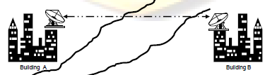
Terrestrial Microwave

Slide 55
Antennas
Electrical conductor (or system of..) used to radiate electromagnetic energy or collect electromagnetic energy
Transmission
  Radio frequency energy from transmitter
  Converted to electromagnetic energy
  By antenna
  Radiated into surrounding environment
Reception
  Electromagnetic energy impinging on antenna
  Converted to radio frequency electrical energy
  Fed to receiver
Same antenna often used for both

Slide 56
ii. Satellite Communication
Satellite transmission is much like line of sight microwave transmission in which one of the stations is a satellite orbiting the earth. The principle is the same as terrestrial microwave, with a satellite acting as a super-tall antenna and repeater
Although in satellite transmission signals must still travel in straight lines, the limitations imposed on distance by the curvature of the earth are reduced.

Slide 57
Satellite Communication
Satellite microwave can provide transmission capability to and from any location on earth, no mater how remote.
This advantage makes high quality communication available to undeveloped parts of the world without requiring a huge investment in ground based infrastructure. Satellite themselves are extremely expensive, of course, but leasing time or frequencies on one can be relatively cheap.

Slide 58
Satellite Microwave
Satellite is relay station
Satellite receives on one frequency, amplifies or repeats signal and transmits on another frequency
Requires geo-stationary orbit
  Height of 35,784km
Television
Long distance telephone
Private business networks

Slide 59
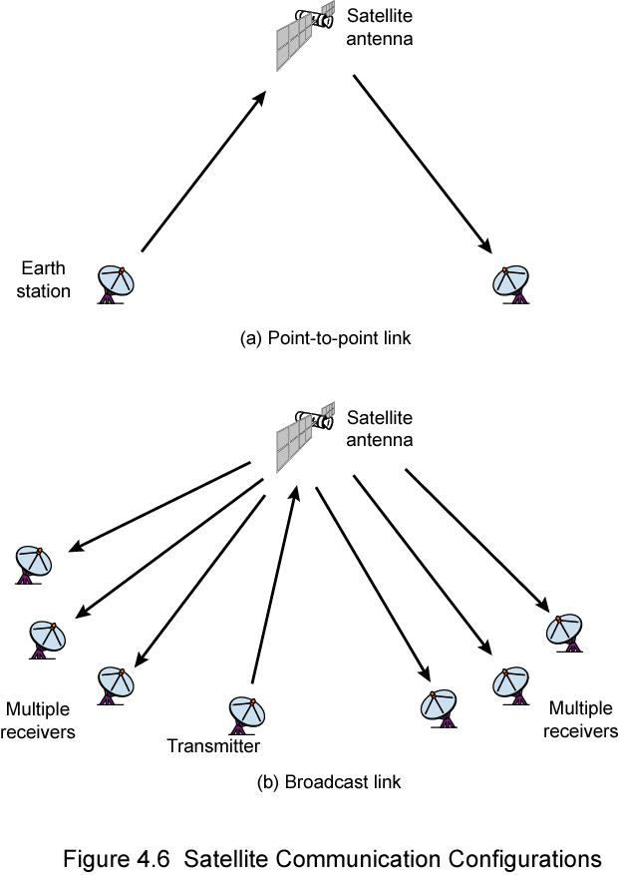
Satellite Point to Point Link

Slide 60
Satellite Broadcast Link

Slide 61
3. Infrared Transmission
Infrared media uses infrared light to transmit signals. LEDs transmit the signals, and photodiodes receive the signals. The remote control we use for television, VCR and CD player use infrared technology to send and receive signals.
Because infrared signals are in high frequency range, they have good throughput. Infrared signals do have a downside; the signals cannot penetrate walls or other objects, and they are diluted by strong light sources.

Slide 62
Wireless Propagation
Signal travels along three routes
  Ground wave
    Follows contour of earth
    Up to 2MHz
    AM radio
  Sky wave
    Amateur radio, BBC world service, Voice of America
    Signal reflected from ionosphere layer of upper atmosphere
    (Actually refracted)
  Line of sight
    Above 30Mhz
    May be further than optical line of sight due to refraction

Slide 63
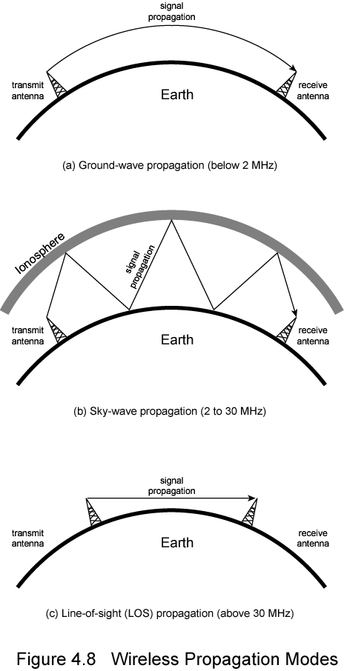
Ground Wave Propagation

Slide 64
Sky Wave Propagation

Slide 65
Line of Sight Propagation

Slide 66
Transmission Impairments
With any communication system, there is a high possibility that the signal that is received will differ from the signal that is transmitted as a result of various transmission impairments.
For analog signals, these impairments introduce various random modifications that degrade the signal quality. For digital signals, bit errors are introduced: A binary 1 is transformed into a binary 0, and vice versa.

Slide 67
Signals travel through transmission media, which are not perfect.
The imperfection causes signal impairment. This means that the signal at the beginning of the medium is not the same as the signal at the end of the medium. What is sent is not what is received.
Three causes of impairment are attenuation, distortion, and noise.

Slide 68
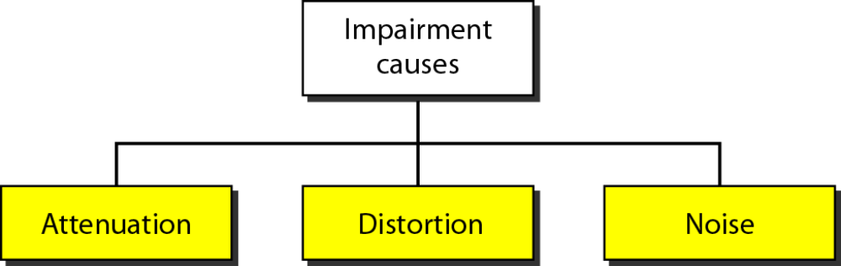
Transmission Impairments

Slide 69
The most significant impairments are the following:
Attenuation
When an electromagnetic signal is transmitted along any medium, it gradually become weaker at greater distances, this is referred to as attenuation. To solve this problem amplifier is used. The amplifier boosts the signals and extends the transmission distance.

Slide 70

Attenuation
• Attenuation means loss of signal strength or energy.
• Amplifier 􀃆 to restore signal strength
• Along with signal noise is also amplified

Slide 71
Attenuation means loss of signal strength or energy.
Amplifier to restore signal strength
Along with signal noise is also amplified

Slide 72
Noise
Random electrical signals that can be picked up by the transmission medium and result in degradation of the data.

Slide 73
Noise – Unwanted signals introduced and/ or natural disturbances
Types of noise
Thermal noise
Induced noise
Cross talk
Impulse noise
Noise may corrupt a signal
Performance degradation
Extra bits
Missing bits
Flipped bits

Slide 74
Delay Distortion
This is a common phenomenon with guided transmission media. The distortion is caused by the fact that the velocity of propagation of a signal through a guided medium varies with frequency. For a band limited signal, the velocity tends to be highest near the centre frequency and fall off toward the two edges of the band. Thus various frequency components of a signal will arrive at the receiver at different times. This effect is called delay distortion.

Slide 75
Jitters
Jitter is a variation or dislocation in the pulses of a digital transmission; it may be thought of, in a way, as irregular pulses. Jitter can manifest through variations in amplitude, signal strength, and other elements of such waves. The usual causes include connection timeouts, connection time lags, data traffic congestion, and interference. Simply put, this jitter is an undesirable output of system flaws and interruptions.

